Slide 1
IRS Form W-9

Slide 2
Copyright Notice
This presentation is copyrighted content. © The University of Tennessee 2013, all rights reserved. Any use other than use by employees of The University of Tennessee is prohibited.
Please contact AP_Vendor@Tennessee.edu if you have questions.

Slide 3
Disclaimer
Disclaimer: this information is intended solely for employees of The University of Tennessee. This information is not legal, accounting, or other professional advice. The University cannot advise vendors on how to correctly complete a W-9.
In the event that information in this presentation conflicts with any IRS instructions, rulings or other applicable laws, the IRS instructions, rulings, or other applicable laws prevail/trump.

Slide 4
IRS Form W-9
Definitions:
IRS: Internal Revenue Service (part of the U.S. Federal government).
“Vendor:” For purposes of this document, “vendor” means any individual or entity that provides a good or service to the University.
W-9: Form created by the IRS for tax record purposes.

Slide 5
IRS Form W-9
Why does the University require me to obtain a vendor’s W-9?
To comply with relevant Federal and State laws and regulations, including IRS regulations and tax laws, the University must obtain a W-9 for all vendors that the University pays.
Complying with IRS rules and tax laws is extremely important.

Slide 6
IRS Form W-9
How can I get my vendor request approved faster?
The University’s Office of the Treasurer receives approximately 50-100 vendor requests every business day. To help you get your request approved faster, please ensure that the vendor’s W-9 that you submit with your vendor request is accurate and complete.
The information in this presentation is designed to help you identify when the vendor has submitted an incorrect or incomplete W-9.
The University cannot acquire goods and/or services from current or former University or other State of Tennessee employees while they are an active employee or within 6 months of their last paycheck or last day on the job, whichever is later.

Slide 7
IRS Form W-9
How can I get my vendor request approved faster?
If the vendor already has a University vendor number that starts with a #1 or a #3, but you need to change the vendor’s primary address (not the vendor’s remit-to address), then email the updated W-9 to AP_Vendor@Tennessee.edu.
If the vendor already has a University vendor number that starts with a #1 or a #3 and already has a remit-to (starts with a #2) vendor number, and all you need to do is update the remit-to address, then email the updated remit to address and the vendor’s W-9 to AP_Vendor@Tennessee.edu.
Note: Remit-to addresses NEVER go on a W-9.
Do not submit a new vendor request if all you need to do is update the primary address and/or the remit-to address.

Slide 8
IRS Form W-9
In the following slides, we will discuss some tips to help you identify when a W-9 is correct and complete.
We will also discuss common mistakes.

Slide 9
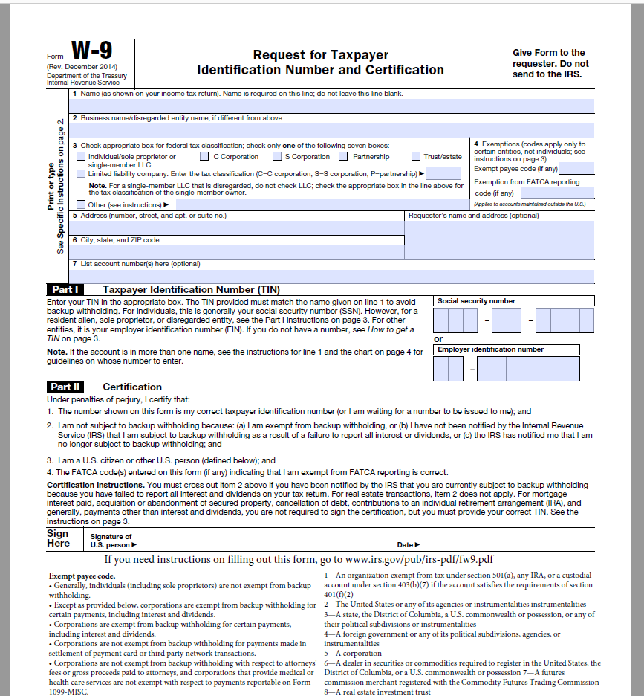

Slide 10
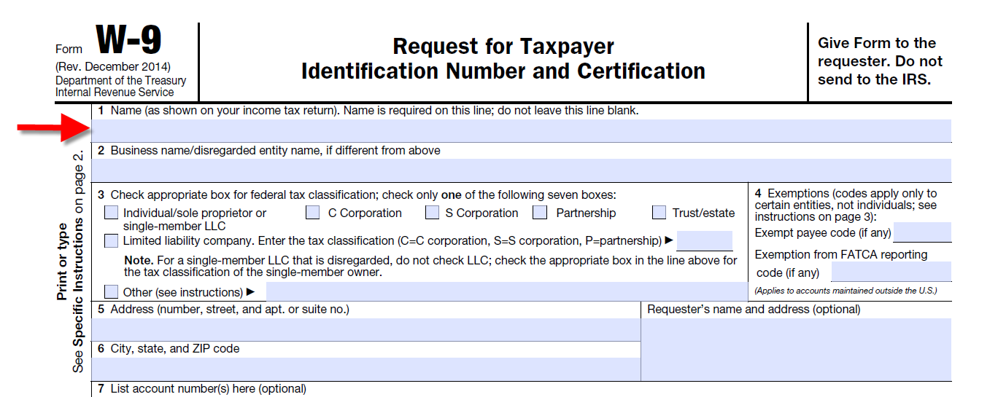

Slide 11
IRS Form W-9
Field: “Name (as shown on your income tax return)”
For individuals: The name in this field must match the name that appears on the individual’s social security card.
W-9’s must never have a “doing business as,” “dba,” or “d/b/a” name in this field.
For sole proprietorships or “single member” limited liability companies (LLCs): The name must match the name on the sole proprietor’s social security card, or, in the case of a single member LLC, the name of the single member that matches their social security card.

Slide 12
IRS Form W-9
Field: “Name (as shown on your income tax return)”
For all other LLCs, corporations, partnerships, and all other entities: The name must match the name as shown on the entity’s Federal tax documents (i.e., the name that is registered with the IRS).
W-9’s must never have a “doing business as,” “dba,” or “d/b/a” name in this field.

Slide 14
IRS Form W-9
Field: “Business Name/disregarded entity name, if different from above”
This is the only field where a vendor’s “doing business as,” “dba,” or “d/b/a” belongs.
If the vendor does not have a “doing business as” name, then this field needs to be blank.

Slide 16
From IRS Instructions for the Requester of Form W-9 https://www.irs.gov/pub/irs-pdf/iw9.pdf

Slide 17
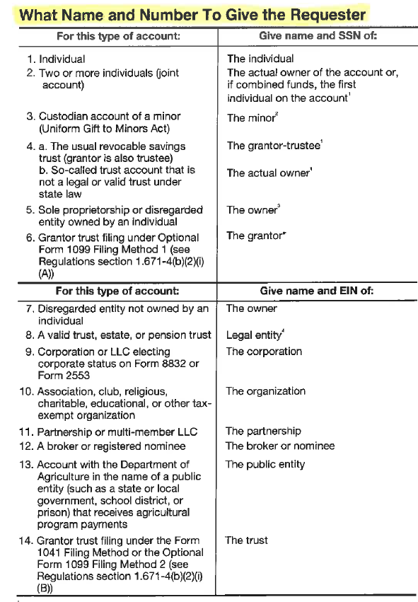

Slide 18
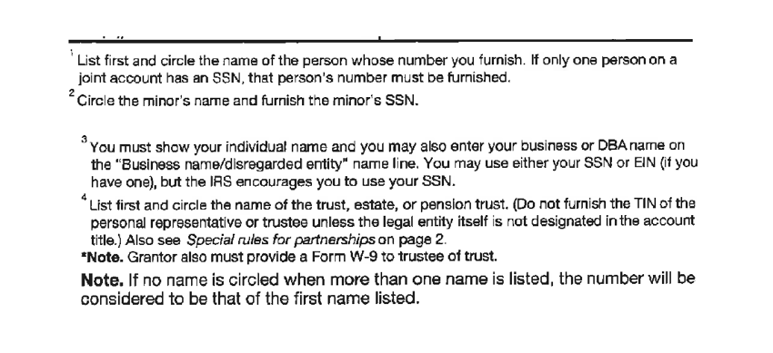

Slide 19
IRS Form W-9
Field: “Check appropriate box for federal tax classification:”
The vendor must select the appropriate box based on their IRS tax classification.
Note: If the vendor marks “Other,” the vendor must add their official IRS tax classification. Simply adding“non-profit,” “not-for-profit,” or “tax exempt” is not acceptable because “non-profit,” “not-for-profit,” or “tax exempt” are not IRS tax classifications.

Slide 20
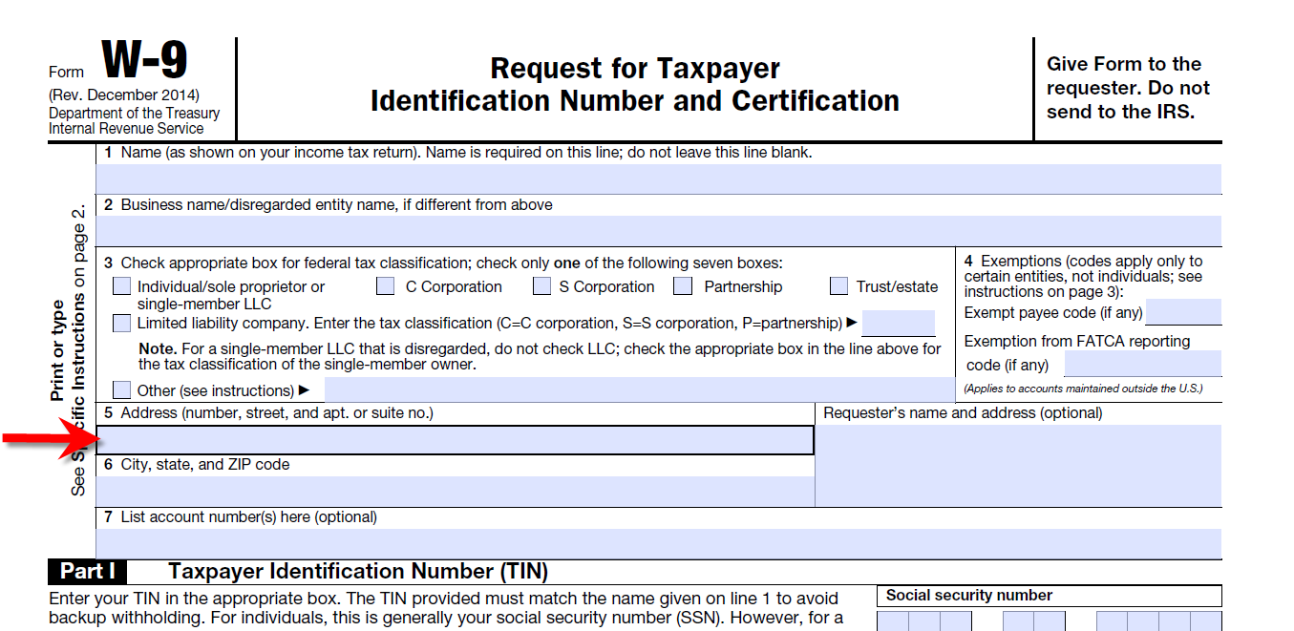

Slide 21
IRS Form W-9
Field: “Address” section:
The address area must contain the address that the vendor has on file with the IRS.
If the vendor’s address and the vendor’s remit-to address are the same, then this address goes in the Address section.
If the vendor’s address and the vendor’s remit-to address are different: the vendor must use the address that is on file with the IRS. Remit-to addresses are NEVER listed on a W-9.

Slide 23
IRS Form W-9
Field: “Taxpayer Identification Number” (also know as a “TIN”)
There are three types of Tax Identification Numbers:
Social Security Number (“SSN”): for individuals, sole proprietorships, and “Single-Member LLCs,” and trusts.
Employer Identification Number (“EIN”): for all other LLCs, corporations, partnerships, and all other entities.
IRS Individual Taxpayer Identification Number (“ITIN”): for resident aliens.

Slide 25
IRS Form W-9
Field: Certification/Signature
All W-9s must be signed by the vendor:
If the W-9 is for an individual, sole proprietorship, or “Single-Member” LLC: only the person whose name appears on the W-9.
If the W-9 is for a partnership, the W-9 must be signed by one of the partners.
If the W-9 is for all other LLCs, corporations, and all other entities: only an officer from the entity whose name appears on the W-9.
All vendors must also put a date next to their signature.

Slide 26
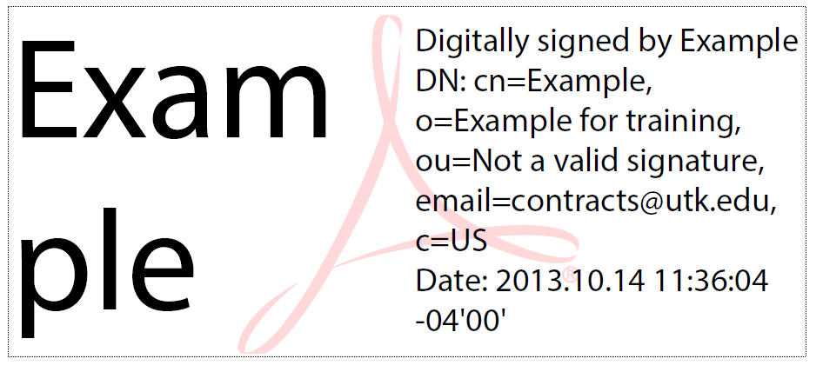
IRS Form W-9
Field: Certification/Signature
What types of signatures will be acceptable?
“Ink” signatures: where the vendor signs the W-9 with a blue or black ink pen.
“Digital” signatures: only the following type of digital signature will be accepted:

Slide 27
IRS Form W-9
Field: Certification/Signature
Any other types of “signatures” will not be accepted (e.g., inked stamps, Microsoft Word “signatures,” etc.).
Only the vendor is allowed to sign their W-9.
UT employees, students, staff, student workers, etc. are NEVER allowed to sign a vendor’s W-9.

Slide 28
IRS Form W-9
Common Problems with W-9s:
W-9s will not be accepted if they have:
white-out or cross-outs,
Illegible writing, or
Multiple ink colors.
The vendor must complete the W-9 before you submit the W-9 to the Office of the Treasurer.
Vendors must sign and date their W-9. UT employees, staff, faculty, students, etc. cannot sign for vendors.
UT cannot acquire goods or services from current or former UT or other State of Tennessee employees while they are active employees or within 6 months of their last paycheck or their last day on the job, whichever is later.
Do not submit a vendor request if all you need to do is update the address for the vendor—this applies to all addresses (addresses that relate to the vendor’s #1 or #3 number and the vendor’s #2 number (remit-to address).
Remit-to addresses never go on a W-9.

Slide 29
IRS Form W-9
Questions?
Please email: AP_Vendor@Tennessee.edu

